Slide 1
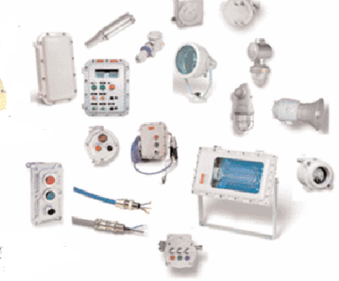
PRESENTATION

Slide 2
ID CARD
SOCIAL REASON | MAGELECT ELECTRICAL COMPANY
LEGAL FORM | S.A.R.L.
CAPITAL | 1.200.000,00 DH
CREATION YEAR | 1979
MANAGER | Mohamed ASRY
ADRESS | 22, Rue de Vimy Belvedere, Casablanca 20300
COMMERCIAL REGISTRE | CASA N° 38263
CNSS | N°1048166
TAX IDENTITY | N° 01600215
PATENT | N° 31203488
CONTACT | E-mail : Magelect@menara.ma Contact@magelect.ma Tél : 05 22 40 72 47 - 05 22 24 45 88 Fax : 05 22 24 72 24 - 05 22 40 71 35
2

Slide 3
SECTOR OF ACTIVITY
MAGELECT specializes in Medium and Low Voltage (MV-LV) electrical installation work, transformer stations and the sale of explosion-proof electrical equipment (ADF).
The electrical work carried out by the company essentially includes:
- The electrification of new industrial units mainly in the oil and gas industry,
- Renovation and maintenance of existing industrial units.
- The realization of electrical installations for the hotel industry, the building, the fitting out of offices and public premises.
- Outdoor public lighting works.

Slide 4
ACTIVITY AREA
MAGELECT is particularly specialized in electrical
Work for the petrochemical, oil and gas industry
such as:
- Oil production unit ‘SAMIR’
- Fuel depot ‘SHELL ET VIVO LUBRIFIANTS-
VIVO ENERGY MAROC – OLYBIA OIL-AFRIQUIA-
TOTAL MAROC-ZIZ-PETROM-PNA-GAZ AFRIC’
-Gas depot GPL
-Gas filling centers ‘BUTAGAZ-SALAMGAZ-
ISMAILIA GAZ’ Afriquia gaz
- Fire protection and detection programs
- Cathodic protection Pipes line
- Study, sale and installation of explosion-proof
equipment. (ADF)
4

Slide 5
MAGALECT Main Customers
VIVO ENERGY Maroc
TOTAL MAROC
OCP
SALAM GAZ
ISMAILIA GAZ
SOCIETE ZIZ
OILIBYA
AFRIQUIA GAZ
AFRIQUIA SMDC
HYDROCARB JORF
SOCIETE PETROM
CEC
ATLAS SAHARA
PNA
CLARIANT
MAROC TELECOM
UNILEVER MAGHREB
COLORADO
SIATRA
TT SUD CARRIRE
SACMI
SAMIR
SCOTIB
SABO FRANCE
GIESECKE & DEVRIENT
I.C.R FRANCE
AKZO NOBEL
CLINIQUE DENTAIRE
HOTEL ANPHITRITE
FAIENCERIE DU NORD
R.A.M
ATLAS SAHARA
GRADERCO
DIMA GAZ
TADLA GAZ
GAZ AFRIC
5

