Slide 1
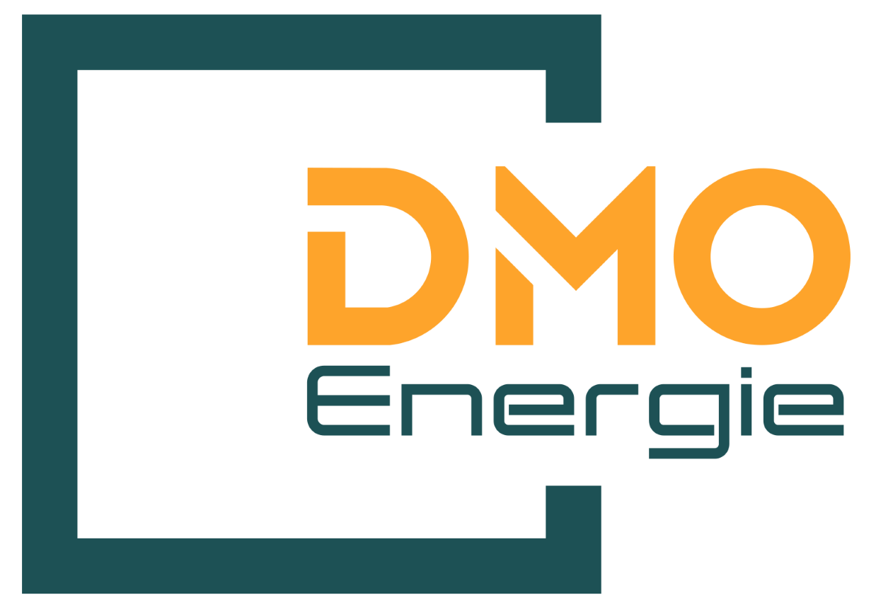

Slide 2
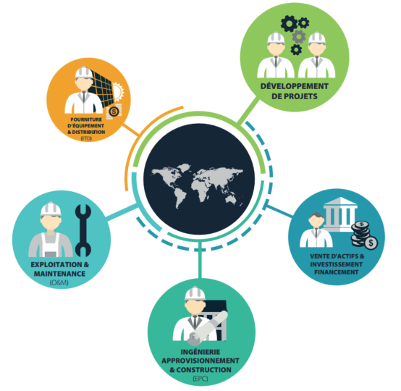
DMO Energie is specialized in the Development, Engineering, Sourcing, Construction, Installation and maintenance of solar power plants.
DMO Energie belongs to EM ENERGIE, a Moroccan group with strong skills in energy, engineering and construction of industrial buildings.
Our goal is to become one of the major electricity players in the installation and construction of solar power plants in Africa.

Slide 3
key figures
DMO Energie - EM Energie Group
+200
+50
Projects
M€ turnover
in 2022
+700
+5
Collaborators
with 70 engineers
Locations
over 4 countries

Slide 4
Our sevices
Energetic performance
Operation & Maintenance
PV self-consumption
EPC construction
Clean energy - competitive energy

Slide 5
Energetic performance
We support you in improving your energy efficiency
Audit & Engineering
Financial engineering
Supply & Installation
Site survey
Inventory of equipment and loads
Implementation of specific tools and measurement application
Analysis of invoices and power balances
Estimation of energy saving potential
Recommendations Implementation
Establishment of appropriate choices and procedures while ensuring the compliance of the installations with the standards & laws
Cost estimate & investment plan
Evaluation of financial gains
ROI & payback

Slide 6
Self-consumption
DMO Energie designs and develops customized solutions for the production of renewable photovoltaic electricity for all types of roofs, ensuring the profitability of the project and its positive environmental impact.
DMO Energie's solutions are perfectly suited to medium and large roofs, and are an option of choice in any type of business sector: industry, agriculture, trading, retail, etc.
We have the experience and know-how to meet your photovoltaic challenge, by offering agile, innovative and efficient solutions.
Energy savings
8 to 20 years
Savings for the customer
Savings for the customer
Financing of the photovoltaic installation project
Coût de l’énergie
Basic consumption
Reduced consumption

Slide 7
Self-consumption
DMO Energie: an integrator present across the entire value chain
Technical Engineering offices…
Owner or operator of buildings
Project management Supply, construction, installation
1 single contact
Legal Construction, lease & rental contracts, ...
Funding Investment budget, project financing,…
Construction Permitting, …
Client request
Reduce consumption in KWh
DMO Energie offer
Savings, global management, financing
O&M Operation, power plants maintenance, etc.

Slide 8
Service proposal
DMO ENERGIE proposes 2 offers, one turnkey and the other third-party financing.
If third-party financing, DMO ENERGIE will carry out the construction of the plant (supply, installation and connection).
DMO ENERGIE will carry out the upkeep and maintenance of the photovoltaic plant (preventive and corrective) as well as the supervision of the plant throughout the contractual period.
DMO ENERGIE will insure the photovoltaic power plant during construction and throughout the period of operating.
The Customer will benefit from all the advantages linked to the installation of the photovoltaic power plant, in terms of the production of self-consumed and injected electricity for 10/15 or 20 years
DMO ENERGIE will transfer the ownership of the photovoltaic plant to the Customer at the end of the contractual period of 10/15 or 20 years.

