Slide 1
ACI
Advanced Cargo Information System

Slide 2
What is ACI ..
In accordance with the new Egyptian Customs law #207/2020 effective as of November 2020, and its following related Decree, Advance Cargo information (ACI) will be strictly mandatory for All Egypt Import shipment as of 1st March 2022.
Advance Cargo information (ACI) is a new customs system that requires cargo data and documents (Commercial invoice, Packing list, Bills of Lading and Cargo Manifest) at latest until 48 hours before the vessel departure from the Loading port.
Under the ACI system, a unique number called ACID number (Advance Cargo information Declaration) to be issued for each shipment. ACID will be issued for each ACI request (maximum within 48 hours from request submission) by Egyptian customs portal - Nafeza.gov.eg

Slide 3
Who does ACI impact?
Importers
Exporters and suppliers (foreign)
Clearance companies
Sea/air shipping companies

Slide 4
The Service..
THE SERVICE The ACI service guarantees valuable access to cargo information well ahead of arrival time so as to allow trade operators to process import/export documentation and timely monitor all movements of goods across borders. The ACI is a web-based application developed by SGS to promote a paperless environment in a number of countries where paper documents are still in use. Upon completion of the ACI form by the exporter, all parties involved in the transaction, i.e. Exporter, Importer, Forwarder, Customs, can access the information in real-time from their offices around the clock. Access rights may vary according to the type of user.

Slide 5
Why ACI ?
MONITORING OF IMPORT/EXPORT GOODS: Valuable statistics can be generated from ACI Information
TRADE FACILITATION TOOL: through the Internet connection fast tracking of information is achieved.
RELIABILITY OF INFORMATION: ACI information is validated by an independent verificator (SGS).
FRAUD DETECTION: documentary cross-checking and risk assessment through Profiler®.

Slide 6
How to prepare for ACI
The Egyptian importer register on the online portal www.nafeza.gov.eg
Obtain the electronic signature pad from competent authorities to access Nafeza.
List advance cargo data and acquire ACID prior to the start of import operations.
Submit cargo data and documents (commercial invoice and final or initial bill of lading) prior to shipment.
Notify overseas exporters dealing with electronic invoice to send all shipment documents to (Nafeza) platform through supply chain networks using Block-chain technology - upon vessel’s departure from the port of export .

Slide 7
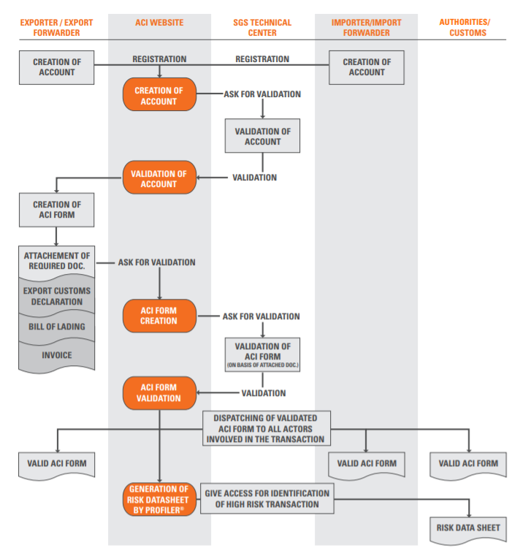
The Main Process

Slide 8
What Exporters need to do??
Pre-registration steps:
Pro Forma Invoice.
Fill in the basic data of the importer and exporter.
They will receive a 19 digit number (ACID).
This ACID number will be sent to the importer who sends it to the carrier to put it in the documents on the Cargo X which has coordination with the Customs which will either approve or disapprove it.
When the goods are received the customs declaration is registered in the name of the person who has delivery permission.

Slide 9
Within 48 hours the ACID number will be created and its valid for only 3 months (90 days), and if it wasn’t used a new ACID should be created again and also it’s validity will be 3 months only.
In most cases the ACID number will be delivered with no problems as the data of the importer and exporter and the commodity is already registered and this is considered a preliminary approval for importation.
Which means that the importer is already registered in the custom’s database.
In this case the exporter is allowed to export to Egypt through as he is approved via the Egyptian Ministry of Trade and Industry and the commodity is allowed to enter Egypt.

Slide 10
CargoX
CargoX has developed BDTS (Block-chain Documentation Transaction System), which offers a platform with many applications, the most popular of which is Smart B / L ™. CargoX created an open system that uses Block-chain technology and decentralized encrypted data storage to enable the creation and exchange of information and documents.

Slide 11
Cargo X Platform Sign up
https://help.cargox.digital/en/user-manual/registration/new-company-registration/
https://help.cargox.digital/en/user-manual/registration/activate-new-account/
https://help.cargox.digital/en/user-manual/managing-company-details/your-blockchain-key/
https://help.cargox.digital/en/user-manual/managing-company-details/company-profile/
https://help.cargox.digital/en/user-manual/managing-company-details/

Slide 12
Data and Document Upload
https://help.cargox.digital/en/user-manual/using-the-platform/
https://help.cargox.digital/en/user-manual/using-the-platform/compose-envelope/
https://help.cargox.digital/en/user-manual/using-the-platform/transfer-envelope/
https://help.cargox.digital/en/user-manual/using-the-platform/forward-received-documents/
Login
https://help.cargox.digital/en/user-manual/logging-in/login/

Slide 13
What is Block-chain Technology?
Block-chain is a technology that allows a person (or company) to transfer valuable data or documents to another person safely and without the intervention of any intermediary.
Block-chain is simply a series of fixed records or blocks of data, and is managed by a group of computers that are not owned by any entity. Data blocks are secured and linked to each other using cryptographic principles.

Slide 14
How the Block-chain Technology works
Block-chain is a simple and innovative method to pass information from person A to person B in a fully automated and secure manner. One Party initiates the transaction by creating a block. That block is verified by thousands, perhaps millions, of computers distributed throughout the network. The verified block is then added to a chain stored in the network, creating a unique record associated with other records. To forge a single record, the entire chain has to be forged on millions of computers, which is practically impossible.

Slide 15
Embassy of Israel – Egypt
Economic Office

