Slide 1
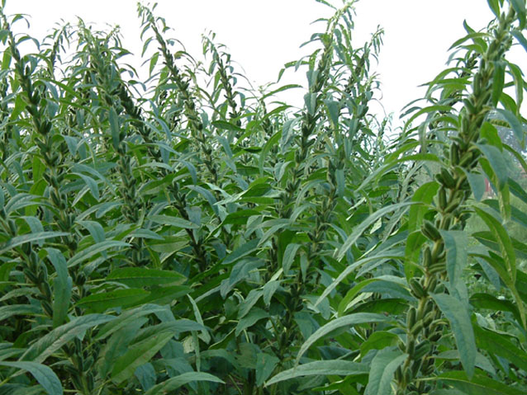
2014
Ethiopia Sesame Outlook

Slide 2
Topics
Country Profile
Sesame Production
Sesame Marketing
Opportunities in Ethiopia Sesame
Challenges in Ethiopia Sesame
Way Forward
Why African Edible Oil Alliance (AEOA)?

Slide 3
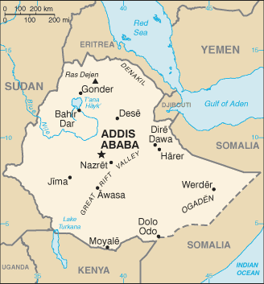
Country Profile
Key Facts
Capital: Addis Ababa
Population: approximately 90 million (2013)
Land area: 1.13 mil sq km (437,794 sq m)
Major religions: Christianity, Islam
Monetary unit: Birr
Exchange rate: 1 USD = 19.95 ETB
Major exports: Coffee, oilseed, Gold, Pulses, Flower, Textiles & Garments, Leather & Leather Products etc…

Slide 4
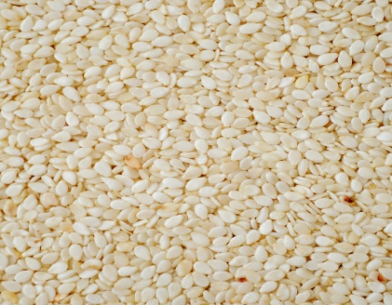
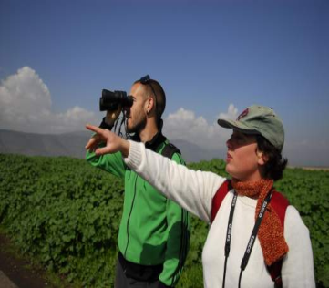
Country Profile …
Economy (2013/14 est.) :-
agriculture: 40%,
industry: 14%,
services: 46 %,

Slide 5
Country Profile …
ETHIOPIA’S ECONOMIC POLICIES
Pro-Market
Pro-Private Sector
Pro- Liberalization
Growth and Transformation Plan - (GTP) as a central plank of its 5 years development Programme

Slide 6
Oilseed Profile of the Country
Oilseed is the 3rd largest crop in area coverage and production after cereals and pulses;
The 2nd largest export earning after coffee ; 2013/14 18.97% & 22.05% share respectively from the country foreign currency earning.
The 4th largest sesame seed producing country in the world;
Engages about 3 million small, medium and large scale farmers;
Government priority commodities to transform to commercial farming.;
Contributes significant role to achieve national household food security in the country;

Slide 7
Oilseeds Production Trend

Slide 8
The Importance 0f Sesame Seed :
Edible oil.
The oil is almost odorless with a distinctive nutty sweet flavor.
Roasted sesame oil resists rancidity due to the antioxidants formed during seed roasting.
Sesame oil is especially important in the Far Eastern cuisine, mainly Japan and China.
Confectionary, biscuit and bakery industry.
Most hulled clear white sesame is required for bakery products.
Hulled sesame sticks to the bread or roll, while maintaining the white colour after baking.
Roasted sesame has a nutty taste.
3. Tahini industry.
Tahini, a traditional Middle Eastern paste, is made from hulled sesame seed and is rich in protein
4. Halva industry.
Halva is a sweet made of 50% tahini, boiled sugar and some other ingredients.
5. Pharmaceutical ingredients.

Slide 9
The world Sesame seed Production export Trend in tones

Slide 10
World Sesame Production and Export
Sesame is produced from 76 countries in the world
The production is mostly dominated by Asian and African countries
The total sesame seed production increased from 2.8 million to 4.2 million tons with annual growth rate of 3.75 percent
Export from 708 thousand to 1.3 million tones with annual growth rate of 6.1 percent
The demand of sesame seed increasing faster than supply

Slide 11
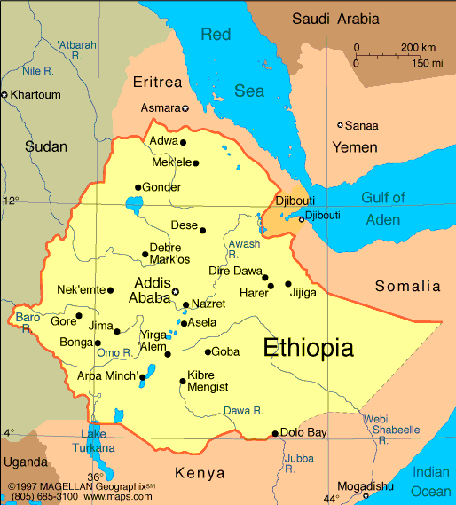
Major Sesame Growing areas in Ethiopia
Humerra/Tigray and Metema/Amhara
W. Wolloga/ Oromia
SNNP

Slide 12
Sesame Cultivation Season
DESCRIPTION | MONTHS
Field Preparation | April/May
Plaughing / Disking | April/May
Sawing | May/June/July
Weeding | June/July/August
Harvesting | October/November

Slide 13
Sesame Seed Production Trend

Slide 14
= Tigray – 130,000 = Amhara – 229,038 = Oromia – 114,000 = B. Gumuz – 71,496 = SNNPR – 50,210 = Gambela – 3,220 NB. Source RBOA (About 3 million SHF are beneficiaries)
2014/15 Sesame Production Plan in Tone

Slide 15
Ethiopia’s Position in World Sesame Production

Slide 16
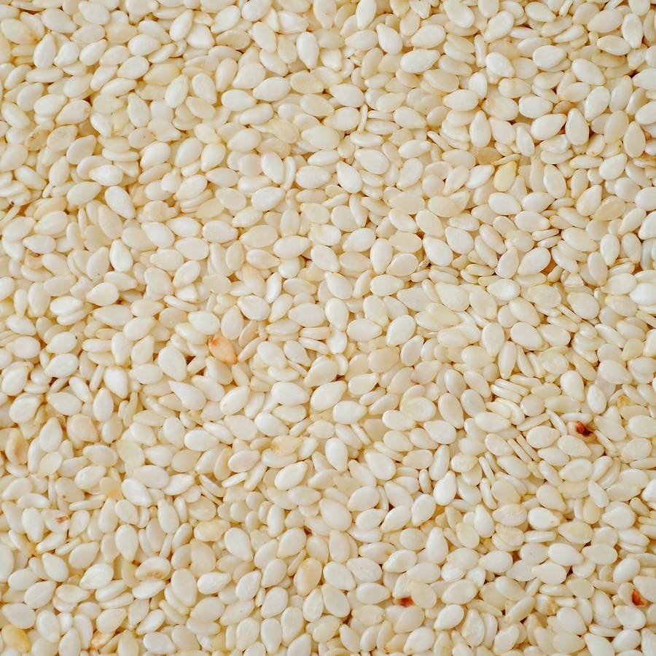
Sesame seeds Characteristics
Appreciated for its aroma and sweet taste;
Whitish color;
larger seeds size;
Good uniform seeds;
48 – 50% oil content;
Used for bakery products, Tahinia confectionary;
HUMERA TYPE

Slide 17
Sesame seeds Characteristics …
Gonder Type
White and whitish
Good uniformity of seed
Used for oil crushing and bakery
Wellega Type
White seeds, with a white to golden colour, are mainly used in raw form because of their aesthetic value and are mostly priced higher than mixed seeds (yellow to dark brown) which are generally crushed into oil
Mainly Small seeds with High oil content 49 -56%

Slide 18
DOMESTIC SESAME MARKETING
Primary Level Transaction Centres
Quality is monitored by extension workers
With common service (data board, loading and unloading platform, dry waste burning and Toilet )
With weighing scale certified by MOT owned by each supplier
392 PLCTCs

Slide 19
Ethiopian Commodity Exchange (ECX):
The 2nd level:-
Receive sesame seed form Suppliers, Producers, and Cooperatives;
Under take, grading, & warehouse services,;
Under take sesame exchange between suppliers and Exporters
Submission of sold sesame to exporters

Slide 20
2013/14 Ethiopia Oilseeds Export in Volume and Value

Slide 21
Ethiopian Sesame Export Trend
Budget year | Volume/mt
2009/10 | 238,832
2010/11 | 218,247
2011/12 | 331,584
2012/13 | 222,705
2013/14 | 269,221

Slide 22
2013/14 Top Ethiopian Sesame Destination Countries
Buying Countries | Volume in Tone | % Share
China | 164,084 | 61.03
Israel | 41,634 | 15.49
Turkey | 16,259 | 6.05
Jordan | 10,180 | 3.79
Saudi Arabia | 7,228 | 2.69
Greece | 5,738 | 2.13
Korea, Republic | 4,627 | 1.72
Japan | 4,332 | 1.61
Lebanon | 2,090 | 0.78
Egypt | 2,083 | 0.77
Others | 10,586 | 3.94
Grand Total | 268,841 | 100.00

Slide 23
Top Ethiopian Sesame Buyers
USD ''000''
Buyers | Volume in Ton
RIZHAO RUNY SHANDONG, CHINA | 29,317.00
AGRE COMMODITES & FINANCE FZE | 13,946.00
RUSHDI FOOD IND. | 11,856.00
OLAM INERNATIONAL LIMITED | 10,749.00
CHINA SADIC INTERNATIONAL TRADE CO, | 9,266.10
HAMAMA MEIR TRADING | 8,268.47
CHINA LIGHT CERERAL MERCHANDISE | 7,687.00
QINGDAO KERRY PEANUT | 8,018.00
AHCOF IDUSTRIAL DEVELOPMENT CO.LTD | 6,536.00
TIANJIN HUACHEN TRADE CO.LTD. | 6,782.00
Others (188) | 156,415.17
Grand Total | 268,840.74

Slide 24
Ethiopia’s Position in World Sesame Export

Slide 25
Major Efforts
Research Support
Extension support
Quality Improvement
Modernizing the Domestic Market
Market Support
Supply Side,
Logistics &
Promotion & Linkage
Close Coordination
National Export support Committee,
Regional Supply support Committee,
Business Economy National Integrated Forum,
Sect oral Ministries)

Slide 26
Challenges of Sesame Production and Marketing
Lack of synergy between Stakeholders;
Weak research and extension linkage;
weak improved seed and modern technology utilization capacity;
post harvest loses;
Weak market infrastructure;
Low market surplus;
Weak logistics service/Transport
Luck of advanced value addition technologies
Low level of information networking and processing
Low Negotiation capacity;
Price fluctuation /Price volatility
Construct default (both sides- exporter and buyer)
High transaction cost

Slide 27
Opportunities in Ethiopia’s Sesame
High Government’s commitment;
Favourable policy environment;
Diverse agro-ecology and climatic conditions;
Well established brand - Positive image of the country as quality sesame producer;
The variety of sesame types;
Potential for volume and quality expansion due to presence of adequate land and inexpensive labour,

Slide 28
Way Forward
Strengthen research and extension linkage;
Improve modern technology utilization capacity;
Improve market infrastructure;
Branding & Promotion by Strengthening Business Diplomacy Capacity;
Capacity Building;
Establishing strong Information system;
Collaboration in establishment of Sustainable financing system;
Collaborate in creation of efficient trade logistic;
Strengthening Public Private Partnership;;
Improve global competitiveness;

Slide 29
* Value Competitiveness * Policy Advocacy * Market promotion * Social Responsibility * Cross Cutting Issues * Environmental Responsibility
African Edible Oil Alliance (AEOA)

Slide 30
END

