Slide 1
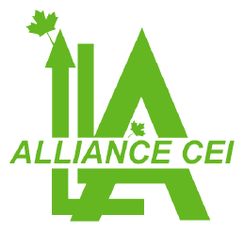
un system de gestion et de traitement des réclamations des citoyens
presentation

Slide 2
Our team
We carry out the work in the field according to the procedures put in place and the objectives to be achieved and respect the rules of hygiene and safety, the quality standards put in place, the planning and the contractual deadline. To carry out the execution of the work, we assign to each intervention a permanent human resource on the site, well structured and equipped with a logistics This human resource is made up of: site managers, engineers, technicians, workers We have a dynamic, motivated and committed team ready to restore fault situations as soon as possible since 2001

Slide 3
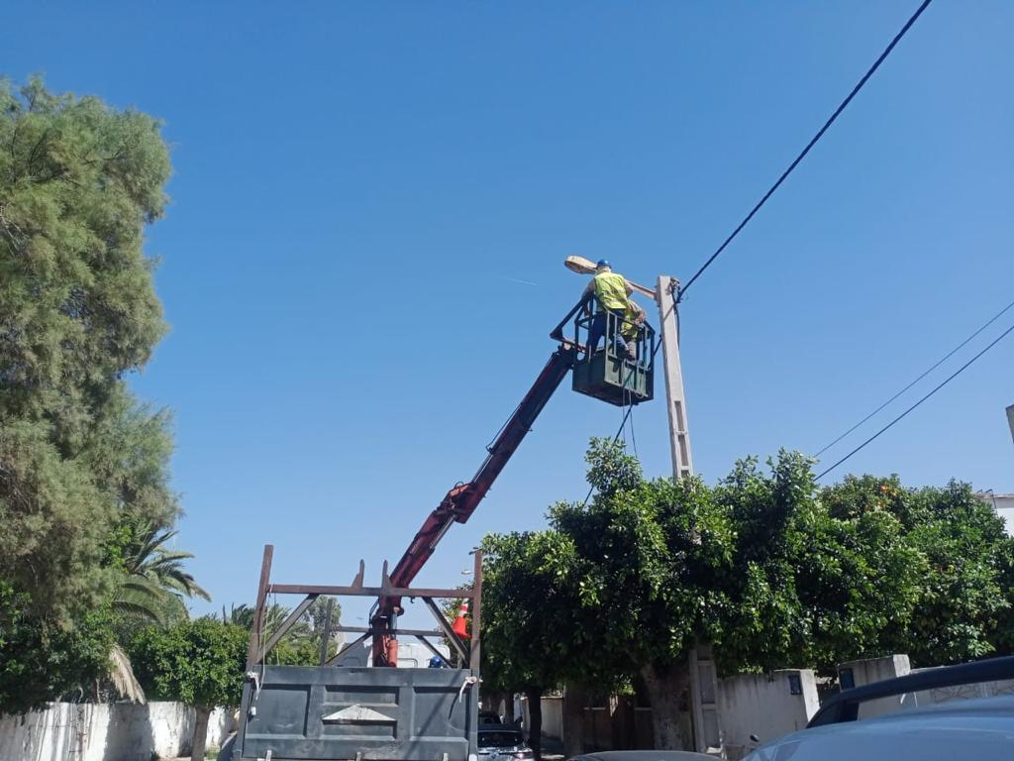
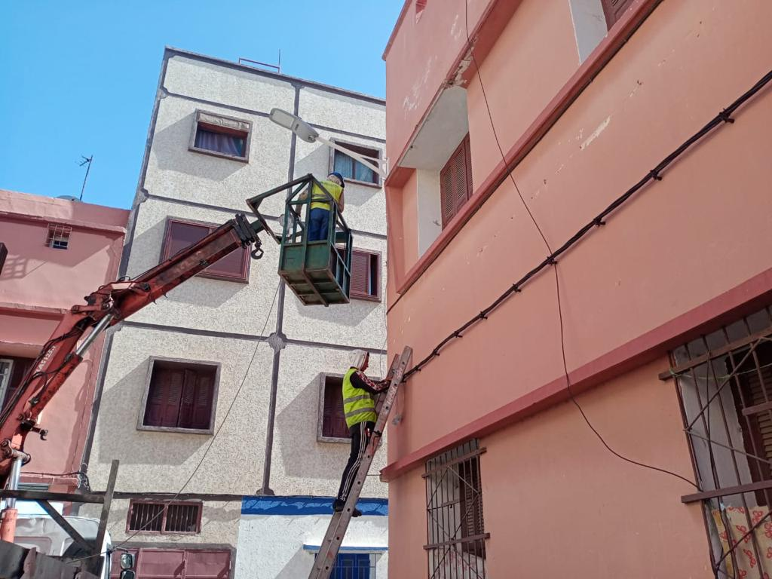
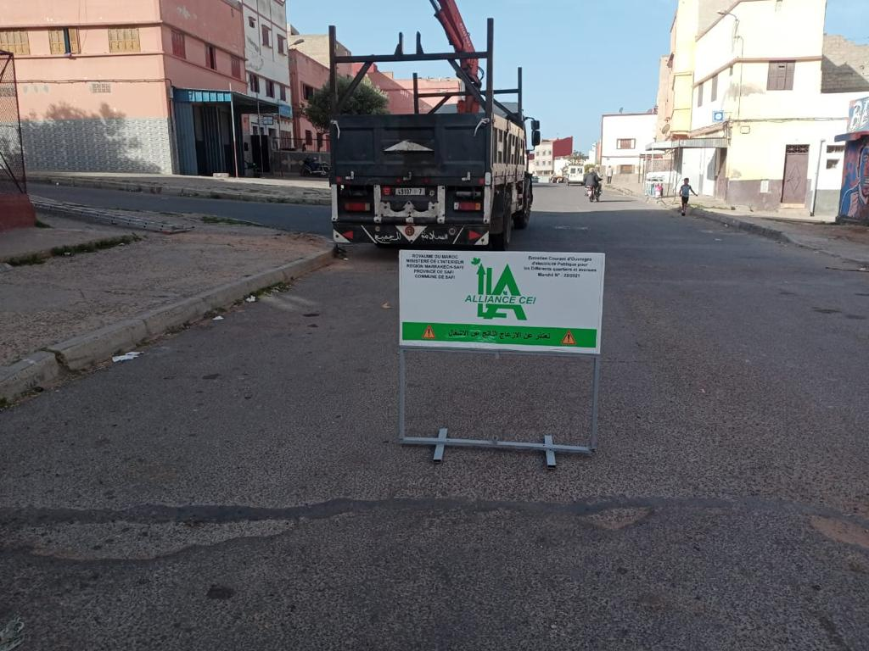

Slide 4
Alliance CEI offers you the best products from the most reputable brands Schneider, Philips, ABB, CLuce for your public lighting installations, switchboards and electrical distribution circuits.
These products are characterized by their efficiency, technology, design, respect for the environment and compliance with safety standards.
We have a permanent stock of thousands of electrical products from major brands, perfectly reliable and suitable for professional conditions of use.
We have an efficient and available sales department to renew and improve our stock in order to ensure delivery to the site on time.

Slide 5
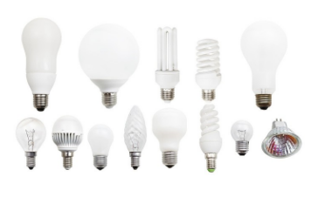
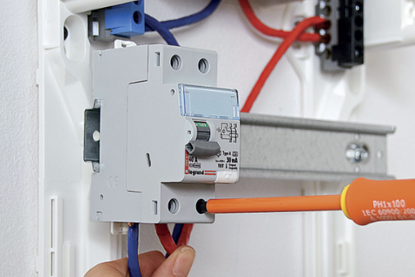
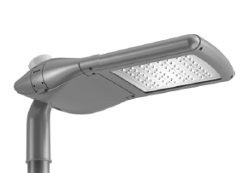
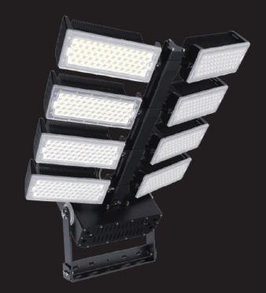
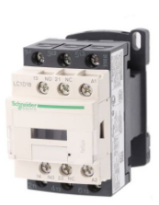
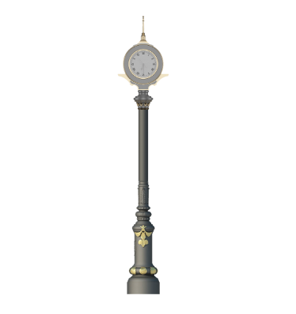
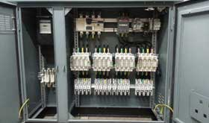
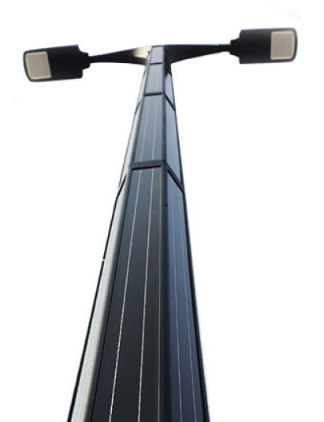

Slide 6
Technical means
Vehicle | Construction equipment | Office equipment
Service car, crane platform truck, crane platform truck, crane truck, concrete mixer truck, shovel dumper, van, Ford transit, compressor. | Wheelbarrow, Sets of shovels, Sets of pickaxes, Sets of ladders, Electrician's box, Complete tool box for site work, Set of individual and collective safety equipment, Set of accessories for unwinding cables (muffles, pulleys, frog ……), Welding station (grinding wheels, drills, Hilti), Measuring device (Metrix)….. | Computer, Stock management software, Payroll software, Accounting software, A4/A3 printers, HP design plotter, network server, Internet, Fax, Scanner, Drawing table, Lot of office supplies….

Slide 7
safety hygiene
We carry out the work in compliance with the rules of hygiene and safety and by adapting the right gestures in order to achieve the objective of zero accidents.
Wear appropriate PPE work clothes (gillet, helmet, shoes, etc.)
The construction site is a place of risk, the most common sources of danger are: Falling from a height, electrocution, risk of fire or explosion….
Regular medical checks for site workers
Beaconing and signaling by billboards
Avoid electrocution for high voltage overhead networks
Protection against risks at height (put on a harness, ensure the balance of the platform, etc.)
Electrical lockout before any intervention on the electrical panels
ADAPTED MEANS OF PROTECTION
Driving license for construction machinery
Protection against the risk of fire and explosion
Emergency and safety procedures in the event of an accident

Slide 8
Quality of work performed
We apply Standard NM 06.1.004/2001 for electrical installations and public lighting. The standard defines the rules applicable to installations located in the public domain and in particular:
To the lighting and illumination installations of streets, parks, gardens, sites and monuments;
Signaling installations, including site signaling;
Miscellaneous equipment, such as telephone booths, bus shelters, illuminated advertisements, maps and signs, parking meters, public toilets.
We have a permanent human resource on site, well structured and equipped with logistics, capable of carrying out the work in accordance with the most recent rules and standards in force.

