Slide 1
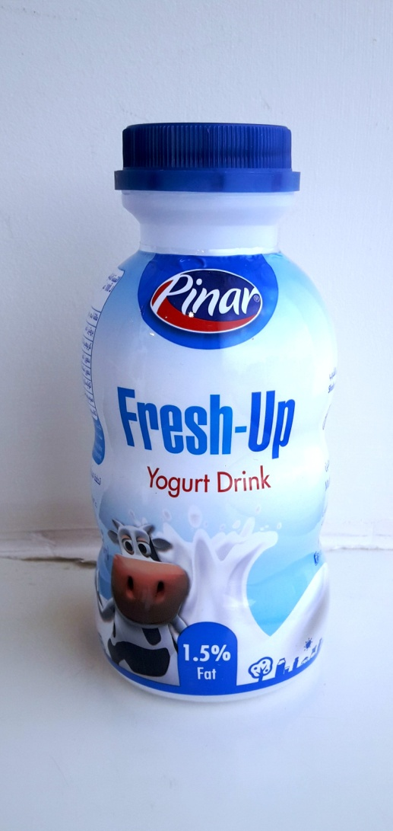
15 - PINAR – Dairy PRODUCTS

