Slide 1
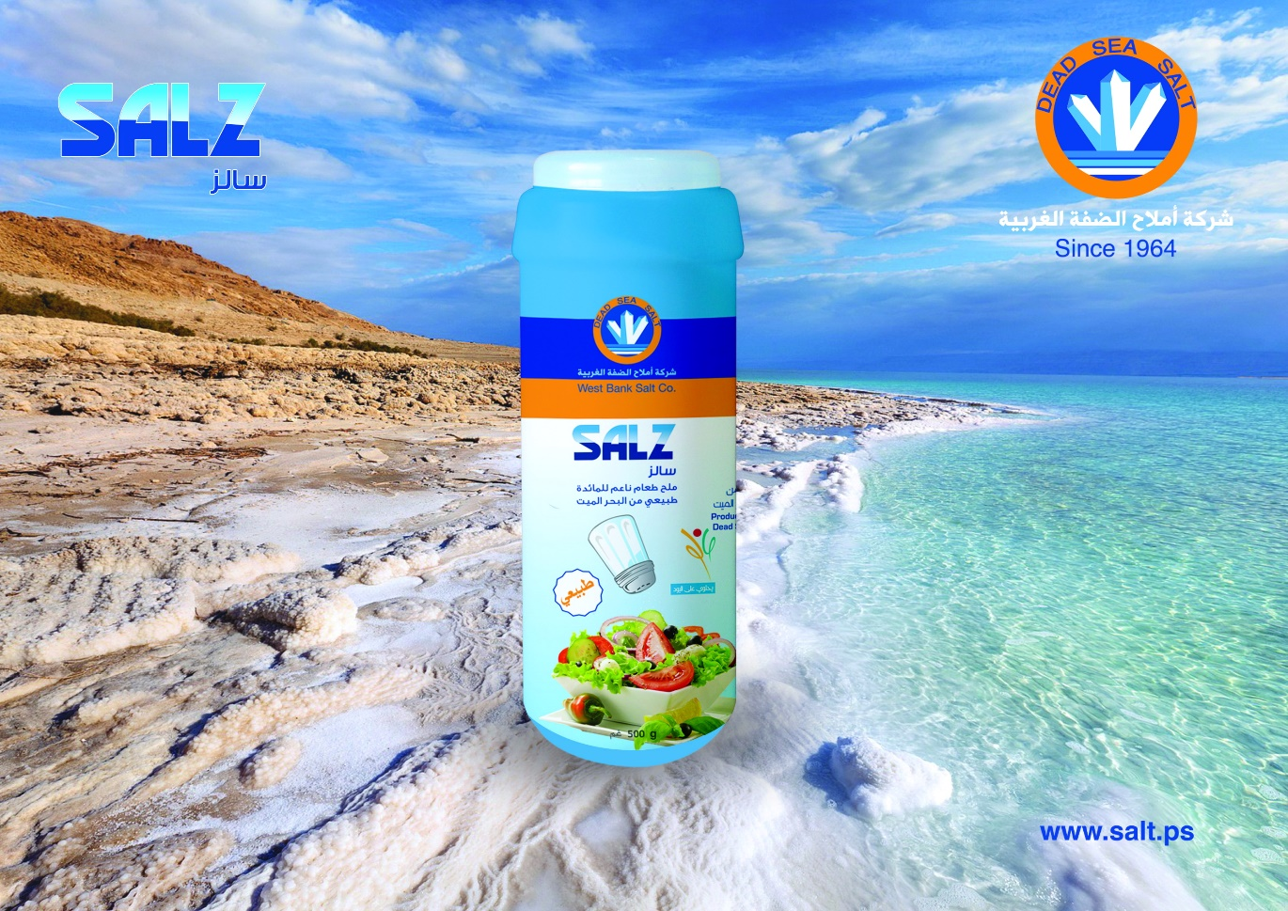
20 - West bank salt

