Slide 1
Cyprus: A dynamic business and investment center
Christos Vasiliou KPMG Cyprus, Deputy Managing Director cvasiliou@kpmg.com
Israel
4 December 2017

Slide 2
Cyprus: a growing economy
Cyprus Economic Forecast
 | 2013 | 2014 | 2015 | 2016e | 2017^{f} | 2018^{f} | 2019^{f} | 2020^{f}
GDP growth (% yoy) | -6,0 | -1,5 | 1,7 | 2,8 | 3,6 | 3,0 | 2,7 | 2,7
Inflation (% yoy) | 0,4 | -0,3 | -1,5 | -1,2 | 1,0 | 1,0 | 1,5 | 2,0
Unemployment (%) | 15,9 | 16,1 | 14,9 | 13,0 | 11,0 | 9,5 | 8,0 | 6,5
Public budget balance (% of GDP) | -5,1 | -8,8 | -1,2 | 0,4 | 1,0 | 1,3 | 1,4 | 1,4
Gross public debt (% of GDP) | 102,2 | 107,1 | 107,5 | 107,8 | 99,0 | 92,4 | 86,5 | 81,8
Note: (a) e: estimate f: forecast
Source: Ministry of Finance, Oct 2017
Source: CYSTAT
Notes:
According to the Statistical Service, the GDP growth rate in real terms during the third quarter of 2017 is positive and is estimated at +3,8% over the corresponding quarter of 2016. Based on seasonally and working day adjusted data, GDP growth rate in real terms is estimated at +3,9%.
General Government accounts for January - September 2017, show that total revenue amounted €5.372,2 mn, while total expenditure reached €4.943,1 mn, resulting in a surplus of €429,2 mn for the respective period.
Cyprus economy is back to growth and sectors like energy, professional services, tourism, mutual funds, construction and real estate, shipping are enhancing this trend;
Developed educational system with schools teaching in English language;

Slide 3
Growth Drivers
Gas Exploration and Exploitation
Tourism
Cyprus Shipping Industry
Research & Innovation
Funds
Real Estate and Construction Industry
Farming and Agriculture
Audiovisual (Budget 2018)

Slide 4
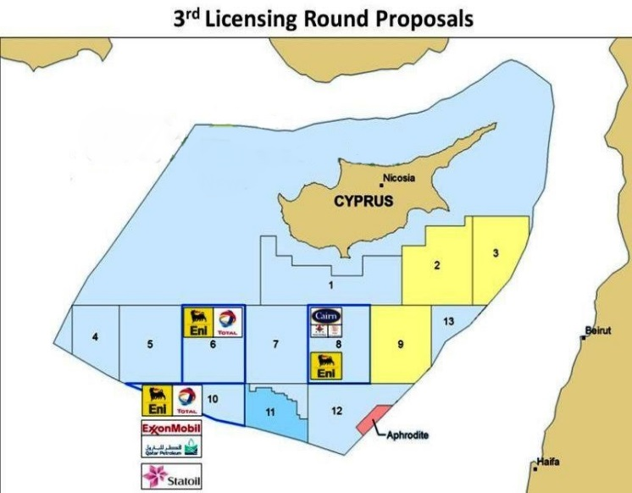
Natural Resources
Energy giants Exxon Mobil as well as major European companies Eni and Total signed exploration and production sharing contracts with the Republic of Cyprus within the framework of the 3rd licensing round for offshore hydrocarbons exploration in Blocks 6,8, and 10 in the Exclusive Economic Zone (EEZ) of Cyprus.
Four to five drillings are expected to take place in Cyprus Exclusive Economic Zone (EEZ) in the next twelve months and by the end of 2018 there will be a clear picture of the island`s hydrocarbon resources and therefore decisions can be made about the exploitation steps.

Slide 5
Growth opportunities – Tourism
Specific foreign investments were recently directed to the tourism industry;
The tender process for the casino resort has been finalized and the government has granted the casino license to the multinational consortium consisting of the companies Melco-Hard Rock and Cyprus Phassouri (Zakaki) Limited;
Construction of a new marinas;
Golf resorts, exclusive hotels and wellness tourism products and services are growing;
Strong links with major tour operators, a significant expansion in flight destinations and the development of niche tourism all indicate the sector will continue to flourish;
Substantial foreign investments have been attracted during the last two years;
Significant prospects for medical and sports tourism.
Notes:
NEW hotel buildings in all seaside cities
+ Incentives for existing hotels to increase capacity

Slide 6
Tourist arrivals in 2017: Keep Growing
 | January | February | March | April | May | June | July | August | September | October | Total
Tourist Arrivals 2015 | 41.799 | 50.709 | 97.479 | 201.495 | 307.449 | 336.967 | 414.527 | 392.272 | 360.899 | 269.363 | 2.472.959
Tourist Arrivals 2016 | 48.607 | 65.988 | 137.013 | 225.575 | 364.943 | 413.114 | 482.132 | 458.645 | 421.201 | 357.194 | 2.974.412
Tourist Arrivals 2017 | 62.611 | 82.209 | 140.873 | 286.331 | 418.732 | 472.450 | 531.030 | 523.651 | 483.716 | 406.870 | 3.408.473
Source: CYSTAT

Slide 7
Growth opportunities – Shipping
More than 140 ship owning and ship management related companies operating in Cyprus
Cyprus has the 10th largest merchant fleet globally and the 3rd largest in the EU, with approximately 1.022 vessels under the Cyprus flag;
Cyprus Tonnage Tax System (TTS) is offering numerous advantages to ship operators, owners and charterers;
This TTS is unique as it facilitates ship owning, ship management and ship chartering at the same time.

Slide 8
R&I Infrastructure
Rapid growth (> € 40m each) of research centres of excellence in:
ICT for monitoring, control, management and security of critical infrastructures (KOIOS)
Interactive media, smart systems and emerging technologies (RISE)
Large scale expansion of University of Cyprus & Cyprus Institute of Neurology & Genetics using large loans of the European Investment Bank
Development of new medical schools & clinical centres
Notes:
R&I = Research and Innovation
ICT = Information & Communication Technology
Research centers = contact with the private world = to turn research into commercial projects
Cyprus can also be used as a testing market for Israel innovations – it is a small and within proximity market

Slide 9
Tax Incentives for investing in innovative SMEs – Start-ups
Who qualifies?
Existing innovative Enterprises: research and development costs represent at least 10% of its total operating costs in at least one of the three previous years
New innovative Enterprises (Start-ups): Assessment based on business plan
Incentives
Income tax relief of up to 50% of taxable income for natural persons investing in qualifying innovative SMEs
Upper limit of deduction €150 000/year
Right to claim the tax relief within a 5-year time period
Start-Up Visa
Notes:
Start-Up Visa is available to individuals/ founders / Need min Eur 50k capital / to employ up to 5 people / based on a Business Plan to be approved, one can approve to get visa

Slide 10
Advantages of Cyprus
Cost-effective jurisdiction with established connections to diverse investor markets
Open market economy with a highly qualified multi-lingual professionals
A firm commitment to develop funds industry
Sophisticated business infrastructure to support the industry
Financial reporting system based on IFRS and legal system essentially based on English Law (Common Law system)
Professional acumen in international structuring
International Memberships: International Organization of Securities Commissions (IOSCO), European Fund and Asset Management Association (EFAMA)

Slide 11
Strong Legal and Regulatory System – Part of EU
Robust
Fully transparent
Fully harmonized with EU Regulations and transposed EU Directives
Based on UK Common Law
In line with international best practice
Commerciality
Notes:
You can rely on our legal system

Slide 12
The Cyprus Tax System at a Glance
12,5% corporate tax on corporate trading profits;
One of the lowest income tax regimes in Europe with taxation reaching up to a maximum of 35%;
50% exemption for income over €100.000 for a 10 year period from date of first employment in Cyprus
Interest expense on 100% corporate acquisitions permitted;
Notional Interest Deduction on new equity invested;
Fully reformed Intellectual Property Regime;
No tax on sale of securities: 100% exemption;
Capital gains from the sale of immovable property situated outside Cyprus are tax exempt;
No withholding tax on outgoing payments (dividends-interest-royalties);
No taxes on corporate dividend income or on profit on sale of shares;
Advance ruling practice exists;
Extensive and constantly expanding network of attractive Double Tax Treaty network.
Non-Domicile Regime
Cyprus Tax Residency

Slide 13
Cyprus DTT Network
Armenia | France | Mauritius | Slovenia
Austria | Germany | Moldova | South Africa
Bahrain | Greece | Montenegro | Spain
Belarus | Guernsey | Norway | Sweden
Belgium | Hungary | Poland | Switzerland
Bulgaria | Iceland | Portugal | Syria
Canada | India | Qatar | Thailand
China | Iran | Romania | Ukraine
Czech Republic | Ireland | Russia | U.A.E
Denmark | Italy | San Marino | United Kingdom
Egypt | Kuwait | Serbia | U.S.A
Estonia | Lebanon | Seychelles
Finland | Lithuania | Singapore
Georgia | Malta | Slovakia
*DTTs not yet in force: Bahrain, Georgia, Iran, Switzerland

Slide 14
Funds & Fund Management

Slide 15
Cyprus Legal framework – AIFs/UCITS
Two broad types of investment funds in Cyprus / One regulator
AIFs under the
Alternative Investment Funds Law of 2014
UCITS under the Open ended undertakings on collective investment Law of 2012
UCITS V was transposed in April 2016
AIF with Limited number of investors (AIFLNPs) up to 75 Professional / well informed investors
AIF with Unlimited number of investors
Registered AIFS
(expected early 2018)

Slide 16
Cyprus Alternative Investment Funds (AIFs)
Achieves the right balance between the freedom of operation of the asset manager and the protection of investor;
Investor base: retail, institutional, professional;
Legal Forms: corporate or contractual type;
Umbrella structures are available with multiple investment compartments allowing ring fencing of assets/liabilities;
Possibility of listing which increases the potential investor base;
Can accommodate a number of investment objectives (PE, Infrastructure, Real Estate, Venture Capital, Funds of Funds);
Complete flexibility as to subscription and redemption terms;
May have multiple classes of shares;
Flexibility as to the terms of calculation of the Management and Performance Fees;
Full transparency: audited annual financial statements in accordance with IFRS, periodic reports to CySEC and the investors.

Slide 17
Legal Forms of AIFS
Investment Company
Variable Capital Investment Company
Fixed Capital Investment Company
Limited Partnership (amendments to the Partnership Law will allow the General Partner to elect for legal personality for the Partnership)
Common Fund (for AIFs with unlimited number of persons only)

Slide 18
Case Studies

Slide 19
Case Study 1 : Variable Capital Investment Company
Composition of the Board:
At least two executive directors (“four eye principle”)
Non-executives /independent directors
INVESTOR SHARES
Commitments
Voting Shares
Drawdown in tranches
Basic Characteristics
The unit value is equal to the net asset value of the shares in issuance at any time
The procedures of the Companies Law regarding the increase and reduction of share capital are disapplied
No filings with Registrar on subscription / redemption
Shares need to be fully paid on issue
Redemption directly out of the assets of the AIF / in kind possible
May be self-managed (by its board of directors) or externally managed
Preferably used for open-ended funds
Variable Capital Company
100%
SPV
Acquisition of equity stake in semi-governmental organisation
Semi-governmental organisation
Notes:
On this slide note what this means also taxwise:
Corporation tax at 12,5% on profits, BUT
Excluded from tax: Dividends, Profits on sale of securities, Capital gains arising from sale of property abroad.
Effectively only interest received is taxed at 12,5%;/ Can be reduced to as low as 2,5%

Slide 20
Case Study 2 : Limited Partnership
General Partner
(Cyprus Company)
Limited Partners
Basic Characteristics
One General Partner who represents the AIF towards third parties and has unlimited liability;
Limited Partners’ liability limited to their capital commitment;
Contractual freedom and tax transparency;
Limited Partnership agreement is not filed with the Registrar of Companies.
Investment Committee
Cyprus Fund structured as Limited Partnership
Cyprus Holding Company
Practical example
Investments are to be made in the renewable energy sector in the former CIS region via a Cyprus Holding Company to secure applicable tax benefits;
One of the Limited Partners is a fund sponsored by the European Investment Fund;
Fund has received a grant from the European Investment Bank to cover expenses of appointing External Technical Expert to the Investment Committee.
Investments
Notes:
conclude that:
The Legal Framework is modern and agile – all in place / EU passporting: Cyprus compares favorably with any other fund center in the EU.
We can deliver cost effective range of services which implies lower costs being transferred to investors.
Capabilities: Professional expertise, systems used, audits, IFRS reporting system.
Significant experience with international markets
Efficient and accessible regulatory authority.
Attractive fiscal framework with strong network of double-tax treaties and other tax benefits.

