Slide 1
Exploring Business Opportunities in Israel and Cyprus
Opportunities in Real Estate
Presented by Yiannis Misirlis
Board Member, Cyprus Chamber of Commerce and Industry
Vice Chairman of Cyprus Land & Building Developers Association

Slide 2
Investing in
Real Estate
“It is a comfortable feeling to know that you stand on your own ground. Land is about the only thing that can’t fly away.” -- Anthony Trollope, novelist

Slide 3
The Real Estate Cycle
HIGH
EXPANSION
OVERSUPPLY
RECESSION
RECOVERY
LOW
Notes:
https://www.biggerpockets.com/renewsblog/2015/03/06/real-estate-marketanalyze-predict/

Slide 4
Transaction Volume: Sale contracts
H2 2017
Projected
sales
H1 2017
Recorded sales
Notes:
http://www.news.cyprus-property-buyers.com/2017/08/03/cyprus-property-sales-july/id=00152701

Slide 5
Other market influences
Recovery of Cyprus Economy
Buyers’ confidence is restored
Abolishment of immovable property tax
Improved process of issuance of Title Deeds
Properties subject to reduced Transfer Fees
Permanent residency program
Properties subject to exemption or reduced VAT
Citizenship programme

Slide 6
Geographical distribution of transactions

Slide 7
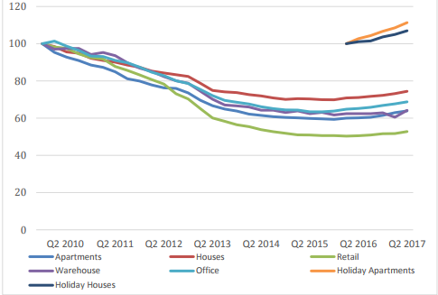
Residential property prices
Average price index (all types)
Following a negative trajectory in RICS index during the years 2010-2015 which turned positive in 2016, there was a further 4% increase as per the RICS Index during Q1 2017.
Increase in both residential and commercial property price indices during Q1 2017, reflecting the higher demand and transaction activity.

Slide 8
Cyprus Economic Overview
GDP Estimated Growth 2017: 3.5%
Inflation in October 2017: 0.5%
Unemployment (Labour Force Survey): 10.6%
Continuous upgrades by International Credit rating agencies

Slide 9
Foreign transaction activity
H2 2017
Projected
sales
H1 2017
Recorded sales
106% increase in no. % of properties sold to foreigners in Half 1 2017 compared to Half 1 2016
Notes:
Please change the graph as discussed

Slide 10
High quality
residences
Ivy Residences by Imperio
Notes:
Please include a real picture and add “… by Imperio”

Slide 11
Commercial
Developments
Noble Centre by Imperio
Notes:
Please add “Noble centre by Imperio”

Slide 12
Luxury Hotels
Amathus Hotel, Limassol
Notes:
Please add “Amathus Beach Hotel”

Slide 13
Key investment advantages of Cyprus
Key Advantages of Cyprus
Strategic geographic location
High level of professional services and human talent
High standard of living and high quality education system
EU Member state
Climate
Attractive-well developed tax system

Slide 14
Is Cyprus a safe place to invest?

Slide 15
Advanced Infrastructure

Slide 16
Large investment projects
Marinas and tourist developments
High-end commercial and residential buildings
Shopping malls
Casino resorts
Golf resorts
Infrastructure projects
Hotels

Slide 17
Casino resort
Casino resort will includes luxury hotel, numerous restaurants, theme parks, water park, bars, cafes, gym and sports facilities, shops, a conference centre and spas.

Slide 18
Marinas
Limassol Marina: In operation
Ayia Napa Marina: Expected to be finished by 2022
Pafos and Larnaca Marina: On the way

Slide 19
The “One”
Notes:
Please check for a better pic

Slide 20
The “Limassol Del Mar”

Slide 21
The “Oval”

Slide 22
The “Icon”

Slide 23
Invest in Cyprus Real Estate today!
Notes:
Please change the picture

Slide 24
Thank you
Yiannis Misirlis
Board Member, Cyprus Chamber of Commerce and Industry.
Vice Chairman of Cyprus Land & Building Developers Association
T: + 357 25581005
F: + 357 25580205 E: yiannis@imperio-group.com W: http://www.imperio-group.com/

