Slide 1
TRANS NZOIA COUNTY GOVERNMENT

Slide 2
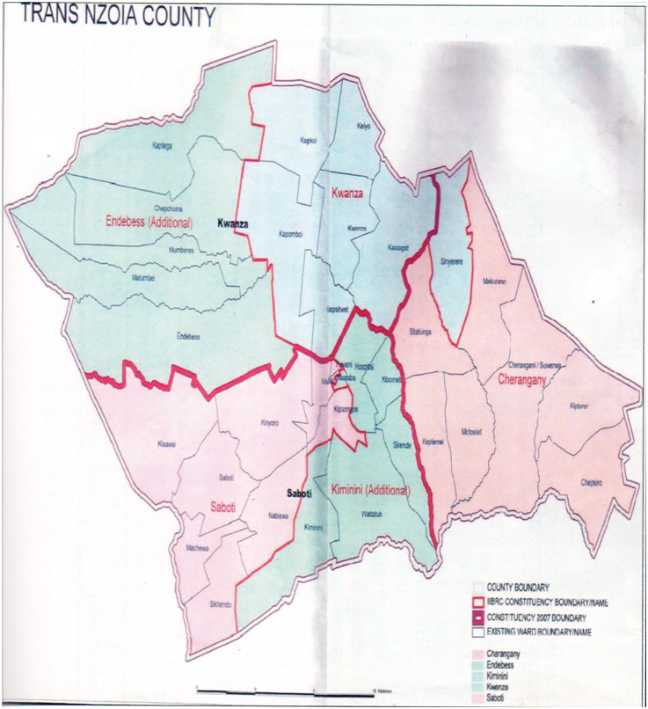
Map of Benue State Showing the 23 LGAs

Slide 3
THE COUNTY AT A GLANCE
Trans Nzoia County comprises five electoral constituencies; Endebess, Cherangany, Saboti, Kwanza and Kiminini. It covers an area of 2,496 sq. km which represents 0.42 percent of the Republic of Kenya’s total surface area. It has a total population of 818,757 persons comprising of 407,172 males and 411,585 females, and with a population growth rate of 3.7%.

Slide 4
THE COUNTY AT A GLANCE CONT’D
Climate: Highland equatorial
Annual rainfall: 900 mm to 1400 mm
Mean temperature: 18.6
Average altitude: 1800 M above sea level
Physical features: Two water towers (Cherangany Hills and the Mt. Elgon), two major rivers(Rivers Nzoia and Suam), over 18 percent total surface area under forest cover
Tourist attraction sites: Saiwa Swamp and Mt. Elgon National Parks with Mt. Elgon being the second highest mountain in Kenya with an altitude of 4,313 metres above the sea level

Slide 5
THE COUNTY AT A GLANCE CONT’D
The county prides itself as the main breadbasket of the country producing an average of 5 million bags of maize annually, representing 1/3 (one third) of all the maize that is produced in the country. Other crops produced in the county include beans, wheat, tea, coffee, and a variety of horticultural crops.
Trans Nzoia County currently generates 120 tonnes of solid waste daily and this provides opportunity for setting a processing plant to generate Energy and fertilizer

Slide 6
INVESTMENT CLIMATE IN THE COUNTY
The following are the reasons why you should invest in Trans Nzoia County
Fully operational and semi-autonomous County Government in place
Political, social and economic stability
Favorable weather and climate

Slide 7
INVESTMENT CLIMATE IN THE COUNTY CONT’D
Abundant natural and artificial resources
Strategic location (borders Uganda and Southern Sudan and 6 counties)
Adequate infrastructure (roads, rail, air, electricity, water and ICT supported by fibre optic connectivity.
Attractive tourism, wildlife and safari destinations.
Availability of business support and financial institutions (Banks, SACCOs, Micro Finance Institutions) including mobile money transfer services

Slide 8
INVESTMENT OPPORTUNITIES IN THE COUNTY

Slide 9
Investment Opportunities in Agriculture
Currently we have land across the counties ear marked for special economic zone.
Location (western region) supports a wide variety of crops, including tree crops like oranges, mangoes, tomatoes, pineapples, pawpaw etc.
River Nzoia provides huge opportunities for Agricultural activities across the counties
Excellent weather conditions suitable for fish farming/livestock production/crop farming
Over 80% of population engaged in subsistence agriculture

Slide 10
Investment Opportunities in Agriculture
High potential for fruits & vegetable oil processing
Livestock/animal feeds production
Starch & Flour Production
Value addition processing factory
Dry inland port land at Kitale -Busia- Malaba (Suam Border)

Slide 11
INVESTMENT OPPORTUNITIES IN THE COUNTY CONT’D
Agriculture is the economic backbone of Trans Nzoia County. There is plenty of farm produce that can be value added. The annual outputs for some of these are as shown table below:

Slide 12
No. | Type of crop | Estimated annual output
1 | Maize | 5 Million bags
2 | Tomatoes | 2600 tones
3. | Sunflower | 13,000 bags
4. | Coffee | 3,200 tones
5. | Tea | 2.5 Million Kgs
6 | Flowers | 3 Million stems
7 | Potatoes | 113,200 bags
8 | Bananas | 3,600 tones
10 | Passion fruits | 100 tones

Slide 13
INVESTMENT OPPORTUNITIES IN THE COUNTY CONT’D
Given the output figures above, various agro-based industries can be established to add value:
Maize milling
Tomatoes processing
Oil extracting
Coffee processing
Tea processing
Horticulture

Slide 14
INVESTMENT OPPORTUNITIES IN THE COUNTY CONT’D

Slide 15
INVESTMENT OPPORTUNITIES IN THE COUNTY CONT’D
Livestock includes: poultry, cattle, goats, sheep, pigs, rabbits, fish, bee keeping, donkeys, geese and camels in the proportions below:

Slide 16
INVESTMENT OPPORTUNITIES IN THE COUNTY CONT’D
No. | Type of Livestock and product | Estimated number and product annual output | Estimated value
1 | Cattle | 174,500 | 400,000,000
2 | Sheep | 160,100 | 105,000,000
3 | Goats | 85,000 | 245,000,000
4 | Poultry | 18720 | 6,600,000
5 | Milk | 88,000,000 lt | 2,340,000,000

Slide 17
INVESTMENT OPPORTUNITIES IN THE COUNTY CONT’D
6 | Fish | 22,815.85 kg | 7,000,000
7. | Pigs | 4,180 | 50,000,000
8. | Rabbits | 6,690 | 13,000,000
9. | Camels | 39 | 5,000,000
10. | Donkeys | 6,580 | 200,000,000

Slide 18
INVESTMENT OPPORTUNITIES IN THE COUNTY CONT’D
This presents numerous opportunities for value addition plants as below:
Milk processing
Meat processing
Leather tannery, bones and hooves processing
Honey processing
Livestock feeds processing
Cold storage facilities
Poultry hatcheries and poultry breeders stocks

Slide 19
Investment opportunities Under water and environment
Through PPP framework the following can be done:-
Development of water supply infrastructure
Solid Waste Management
Irrigated Agriculture
Technical support (capacity building)

Slide 20
Tourism Sector
Investment opportunities are but not limited to:
Construction of tourist resort centers e.g. Mt. Elgon National Park
Hospitality facilities; hotels, conference centers, casinos, lodges and theatres.
Modern cultural centers, amusement parks, fitness and training centers
Golf and sport resorts
Establishment of tour and guide firms etc.

Slide 21
Health Sector
The current county health statistics are; Doctor to population ratio is 1: 28,705 and Nurse to population ratio is 1: 2,178. This indicates need to reduce on the ratios and improve on access to health services.

Slide 22
Opportunities in the health sector include:
Provision of rehabilitation centers, mobile clinics and mobile blood transfusion centers
Modern referral hospital equipped with Diagnostic centers for mammography/Computerized Tomography (CT) scanning
Emergency medical transportation services

Slide 23
Opportunities in the health sector cont’d
Research and development of herbal medicine
Medical education and training institutes (for medical doctor, nursing and paramedical schools, and eLearning platforms),
Manufacturing of pharmaceuticals, medical supplies, medical equipment, and biosciences.

Slide 24
Education
There is generally high enrolment rate (85%), transition rate (78.6%) and completion (81.55%) rate in primary schools and similar trends are recorded in secondary schools. However, the level of absorption to intermediate and tertiary schools is low due to inadequate training facilities. This calls for intensive investments in areas listed below:

Slide 25
Opportunities in the education sector
Primary and secondary schools
Colleges and vocational institutions for training and skills development
Modern science, technology and innovation laboratories
Universities with capacity to conduct Research and Development

Slide 26
HOUSING SECTOR
The investment prospects in housing sector are:
Construction of residential houses/estates
Construction of go-downs and storage facilities
Provision of environment friendly construction materials e.g. soil stabilized bricks.

Slide 27
Information Communication Technology (ICT)
The following are potential prospects in this sector:
Institutions for training, hardware and software development and management
Business Process Outsourcing centers and Call centers
Computer hardware and software incorporations
Digital communication technologies and broadcast network
Data Center and Disaster Recovery Centers

Slide 28
Mining
Mining is a relatively new but thriving explorative economic activity in Kenya. In Trans Nzoia County, traces of Graphite have been reported at Cherangany hills. Other minerals reported are asbestos and vermiculite. These and more elements require further study before explorations.

Slide 29
Trade
Possible areas for investment in trade include establishment of:
Establishment of a county holding company
Establishment of a county maize milling plant
wholesale and modern retail markets
shopping malls
development of street lighting through digital advertisement

Slide 30
Energy Sector
The opportunities in energy sector are:
Harnessing of renewable sources of energy including solar and wind
Investment on energy saving sources of cooking fuel to aid curb deforestation
Conversion of environmental wastes to produce fuel energy

Slide 31
Thank You
Trans Nzoia County Government
P.O. Box 4211-30200, Kitale
Tel: (054) 30301/ (054)30302
E-mail: countyoftransnzoia@gmail.com

