Slide 1
AGRICULTURAL TRADE TOUR
TEL AVIV ISRAEL 19TH – 24TH OCT. 2015
Business investment and development OPPORTUNITIES in western BELT BOARDER region
MARTIN W. W.WALIAULA
COUNTY CHIEF EXECUTIVE OFFICER
KNCCI –TRANS NZOIA COUNTY

Slide 2
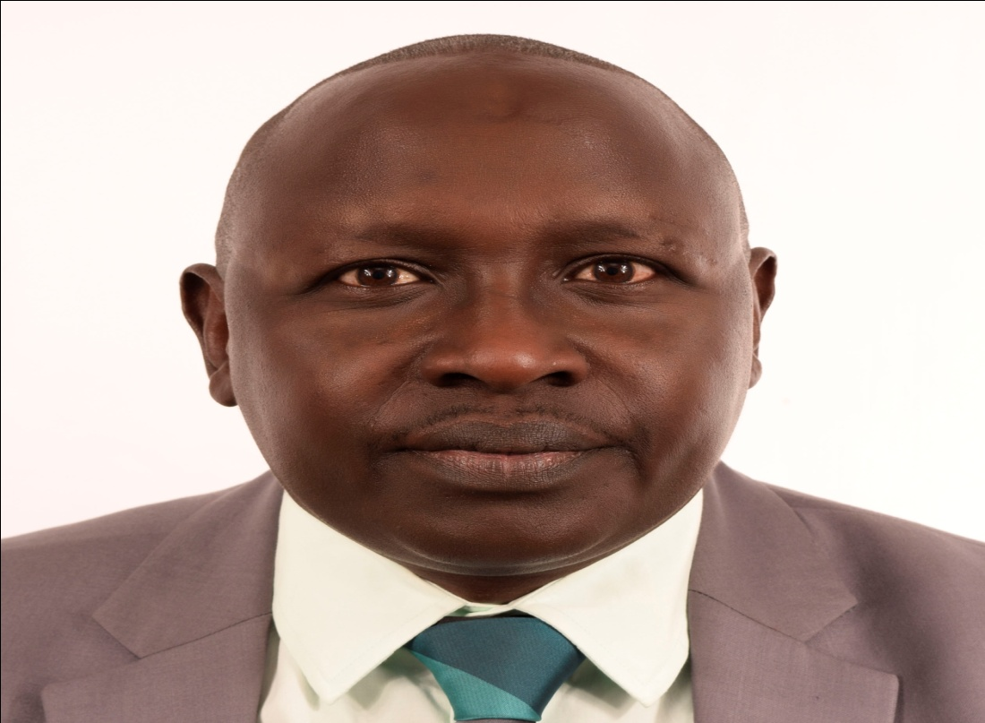
Head of Delegation
H.E Dr. Stanley Tarus Kenei
Deputy Governor
County Government of Trans Nzoia

Slide 3
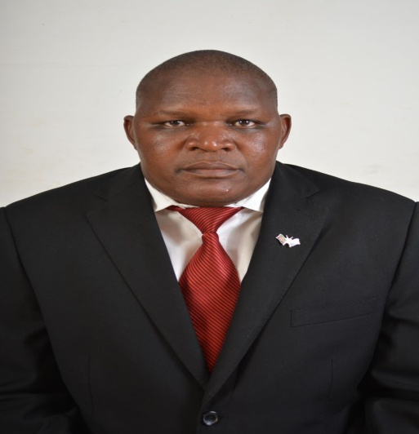
Coordinator of the Delegation
Martin W. W. Waliaula
County Chief Executive Officer
KNCCI-Trans Nzoia County

Slide 4
VISION, MISSION ,AIM AND OBJECTIVES OF KNCCI
VISION:
To spearhead the development of Commerce and Industry
in Kenya and Trans Nzoia County.
TRANS NZOIA COUNTY

Slide 5
TRANS NZOIA COUNTY
MISSION:
To coordinate and promote competitive local commerce and industry by articulating the genuine, legitimate needs and interest of our members.

Slide 6
1.3 Bilateral Relations
Kenya has long historical bilateral relationship with Israel underpinned by the signing of several Agreements and Memorandum of Understandings (MOUs) including the following:
Agreement on cooperation in public security issues between Kenya and Israel on 14th November, 2011
Memorandum of Understanding on defense Cooperation, 2011
Agreement on Classified Technology, 2009
Agreement on water Resource management, Technologies, Irrigation and Capacity Building, 2009

Slide 7
CONT.
Memorandum of Understanding on Consultations between the Ministry of Foreign Affairs of the Republic of Kenya and the Ministry of Foreign Affairs of the State of Israel, 2007
Cultural, Educational and Scientific Co-operation, 1994
Bilateral Air Services Agreement, 1990
Agreement on Technical and Scientific Cooperation 1989

Slide 8
Western Belt Border region counties
Consisting of Trans Nzoia , Busia, Vihiga, Kakamega & Bungoma & West Pokot
Located in Western Part of the Country, surrounded by & shares international boundary with Uganda.
Western region counties demographic details
Trans Nzoia county- 818,757
Busia County 816, 452
Vihiga county 612,000
Kakamega County 1,660,651
Bungoma County 1,630,934
West Pokot 512, 690

Slide 9
WESTERN BELT BORDER REGION COUNTIES
Annual rainfall: 146 – 150.9 mm spread over 7 months of the year (April – October)
Temperatures: range between 21 – 32 ⁰C
Relative humidity 70 – 90% during the rainy season
Soil: fertile and well drained alluvial soils which favour the growth of a wide range of cereals tree crops

Slide 10
Our Comparative Advantages…
Fertile soil suitable for production of cash crops/fruits like Maize, Bananas, soybeans, , oranges, mangoes, tomatoes, pineapples, palm fruits, sugar cane, Shea nuts etc.
Large deposits of solid minerals in all County Governments.
Abundant human resources (skilled & unskilled) supported by a large number of educational institutions
Vibrant mass media comprising of 7 broadcasting stations (Radio/TV) and 1 Newspapers and Magazines

Slide 11
Investment Opportunities: physical & topographical features
Waterfalls and springs/Islands ideal for resorts.
Heritage/Cultural Tourism (native attires, dances, artifacts etc.)
Mt. Elgon (4313m)
Wildlife tourism: Mt. Elgon National Park
Cherangani Hills (3371m)etc.
River Nzoia
Forests
Crying stone- kakamega

Slide 12
An Enabling Environment for Investment
High level commitment to security of lives and property
Anti-corruption and transparent business environment through PPP
Well serviced Industrial Layout for factory development

Slide 13
Enabling Environment for Investment
Easy access to land allocation and issuance of titles and deeds.
5,4 & 3-star hotel rooms for tourists & visitors
Adequate network of roads linking the rural areas and urban centers
Sustainable Government-Private Sector Inter phases (PPP)
Hospitable people with excellent community orientation

Slide 14
...Enabling Environment for Investment
Infrastructural Development especially Roads
Vast Agro lands for cultivation
Kitale Airstrip connecting through lodwar & Eldoret serving western region.

Slide 15
Development Challenges
Underdeveloped infrastructure
Huge post-harvest losses due to limited agro-processing capacity.
African Market Access
The challenge of generating sufficient electricity to power industrial development
Low of technology for irrigation farming
Incidences of HIV/AIDS

Slide 16
Areas of Collaboration
Increase Trade and investment between Kenya and Israel
Establishment of the Joint Trade and Investment Council that will facilitate trade between Kenya and Israel
Establish Joint Trade and Investment Database
Exchange of information and business delegation
Capacity Building on Entrepreneurship and business development

Slide 17
Cont.
Promotion of Joint ventures between Kenya and Israel Business Community
Business to Business (B2B) and Business to Government (B2G) forums to address the affairs and non tariff barriers to trade and investment between the two countries
Agro Produce Marketing and MSEs partnerships
Cultural diplomacy in Arts, Crafts, Fabrics and Entertainment

Slide 18
For more information please see contact us on:-
Kenya National Chamber of Commerce & Industry – Trans Nzoia County
Tel : 0726-100-789
0701 557 111
Email: kncci_kitalebranch@yahoo.com
martinwaliaula@yahoo.com

Slide 19
Thank You

