Slide 1
Notes:
1

Slide 2
GRI is a leading international apparel and accessories brand-management and retail-distribution network, with a core focus on Asia, especially China. GRI has design studios in New York and Paris.
Today, GRI has a retail network of more than 500 locations in the Asian region and Europe.

Slide 3
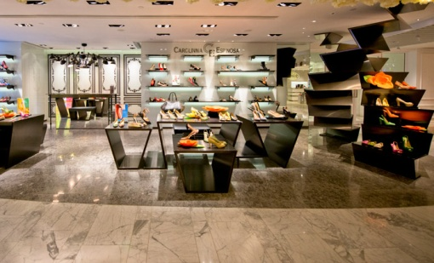
Omni channels integration strategy
Third Party Marketplace for targeted customers
Store & B2C
Hot new products for VIP
LOnline Discount Outlet
Leverage local online marketplaces to break through online sales
First 3 year average growth annual rate: 68%
Future 5 year plan: online sales 6 times from now

Slide 4
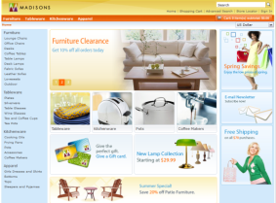
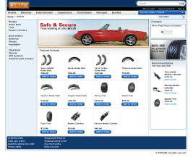
Omni channels integration strategy
Powered By
B2C platform
B2B platform
Omni-Channel Sales Access
BDT platform
BDT:
Multichannel Order MGN
Developed By Joint Lab
Between Lake Cloud and IBM
CDL
Smart OMS for China
Product MGN
Order MGN
Return MGN
Virtual Inventory
Report
Distributor MGN
Interface MGN
Member MGN
Account MGN
Back end system
CRM
WMS
ERP
BI

Slide 5
http://www.htceshop.com/
Presale with Sina Weibo
Presale
Customization
Bundle Sales
Highlight:
SNS marketing, expanding consumer base

Slide 6
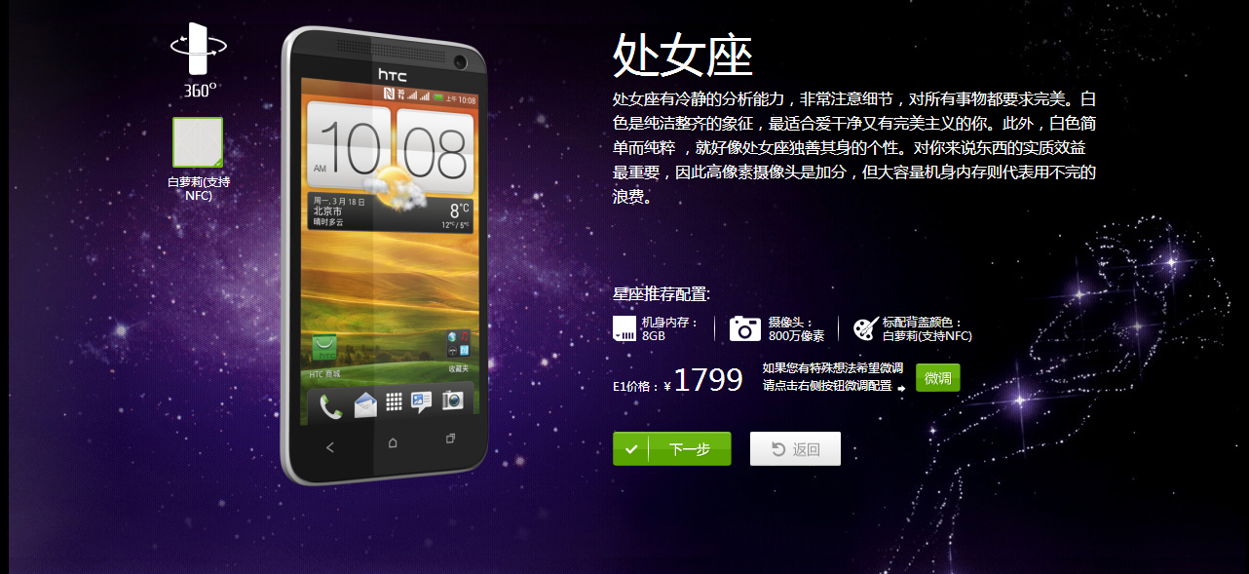
http://www.htceshop.com/
Customized Mobile Phones
Presale
Customization
Bundle Sales
Highlight:
Personalized marketing, better shopping experience

Slide 7
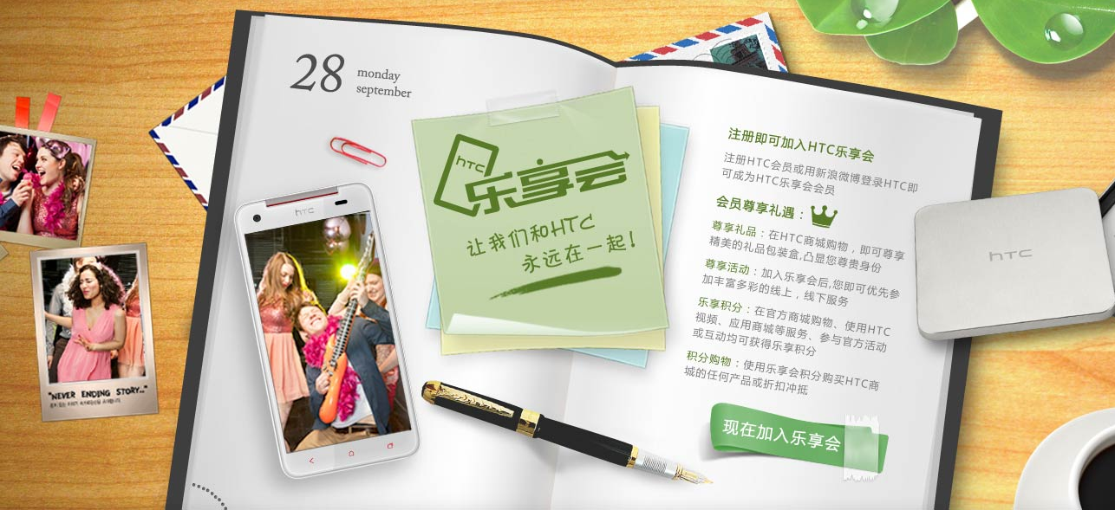
http://www.htceshop.com/
Integrate with HTC Sense
Presale
Customization
Bundle Sales
Highlight:
Integrating HTC global membership/loyalty program

Slide 8
http://shop08.szneiyi.com/
Cosmo – Lady
Cosmo – Lady
E-Commerce Platform
First B2B Customer in China Based on WCS
Highly Customized implementation
Quick Delivery within 2 months

Slide 9
http://shop08.szneiyi.com/
Cosmo – Lady
Step 1: B2B platform for the Franchiser
Step 2： Increase the
inventory fulfillment rate
Step 3：
Integration of ILOG
Cosmo – Lady
E-Commerce Platform
Step 4：Construct a B2C platform
Step 5：Integration offline stores
to achieve O2O

Slide 10
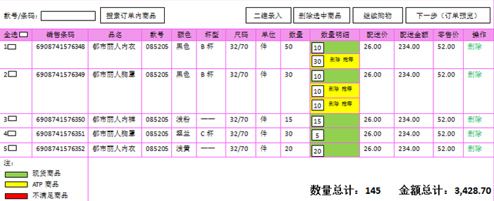
http://shop08.szneiyi.com/
Cosmo – Lady
B2B
ATP Support
Digital Ordering System
（B2B）
Smart Order Analysis
B2C User Experience (With Shopping Cart)

